Slide 1
Unit 5
Quadratic Functions

Slide 2
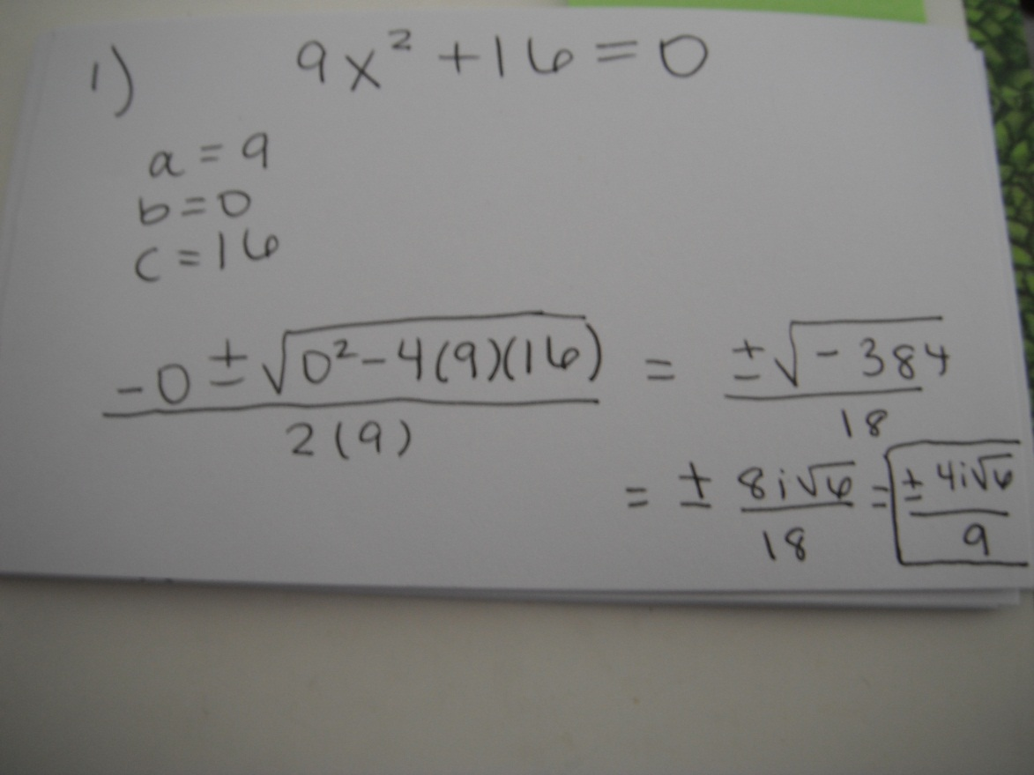

1. Solve 9x²+ 16 = 0 for x.

Slide 3
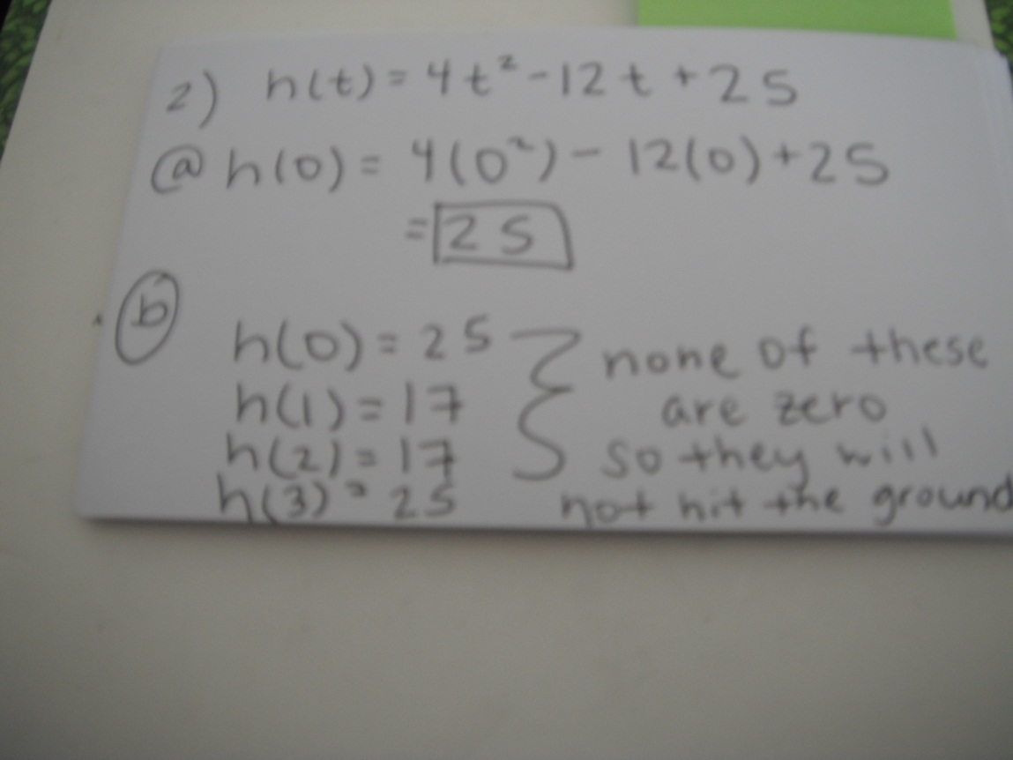
2. The function h(t) = 4t² – 12t + 25 represents the height, in inches, of a swing after t seconds, for 0 ≤ t ≤3.
a. Solve the function when h(t) = 0.
b. Will the swing touch the ground?Explain how
you know.

Slide 4
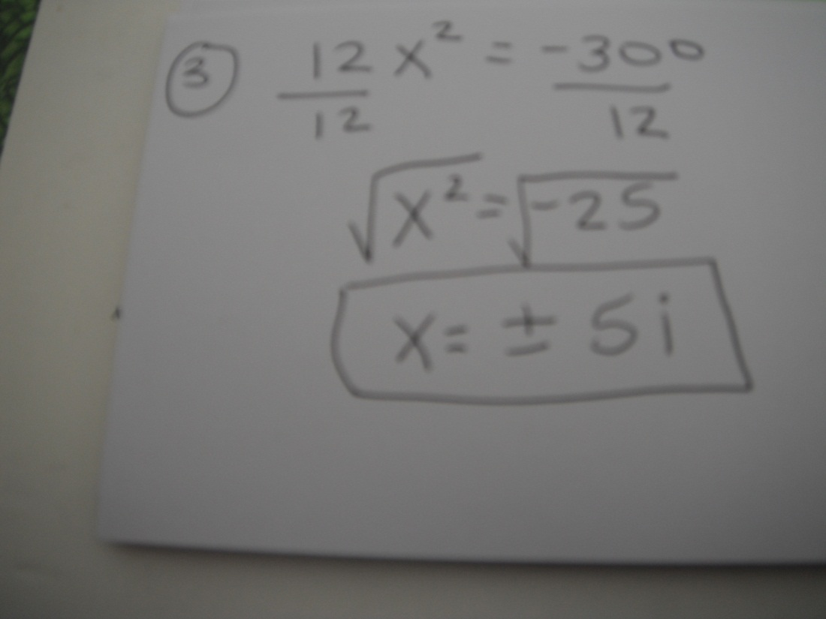
3. What are the solutions to the equation 12x² = –300?

Slide 5
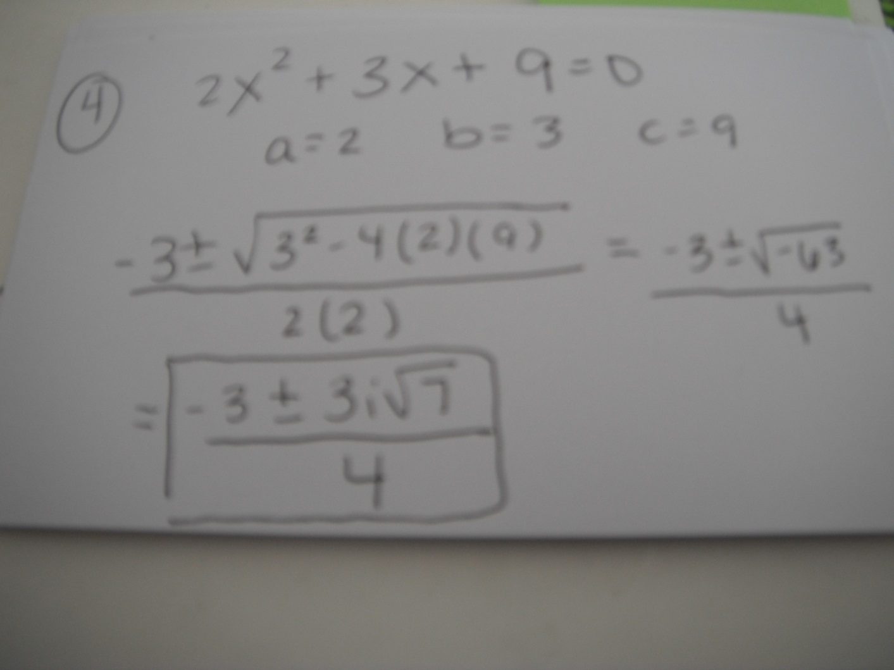
4. What are the solutions to the equation
2x² + 3x + 9 = 0?

Slide 6
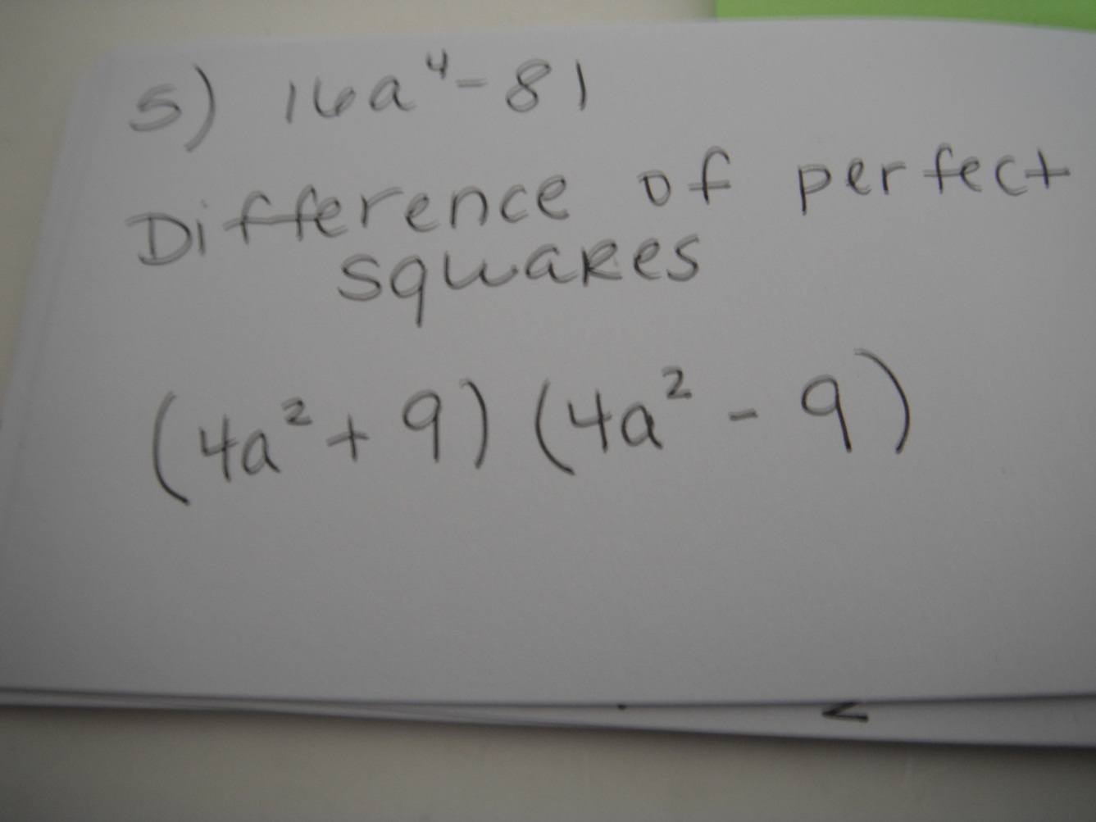
5. Factor the expression 16a⁴ – 81.

Slide 7
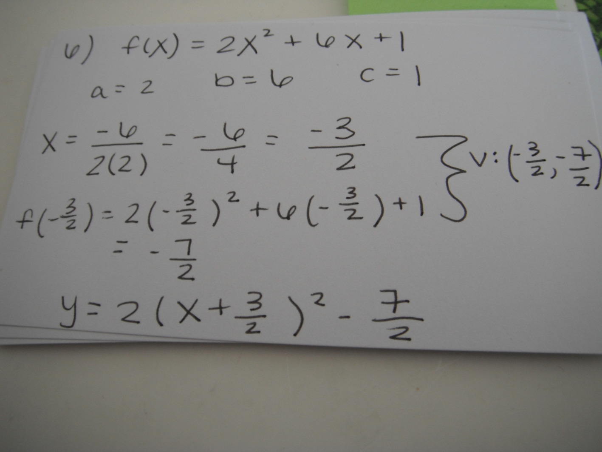
6. Write f(x) = 2x² + 6x + 1 in vertex form

Slide 8
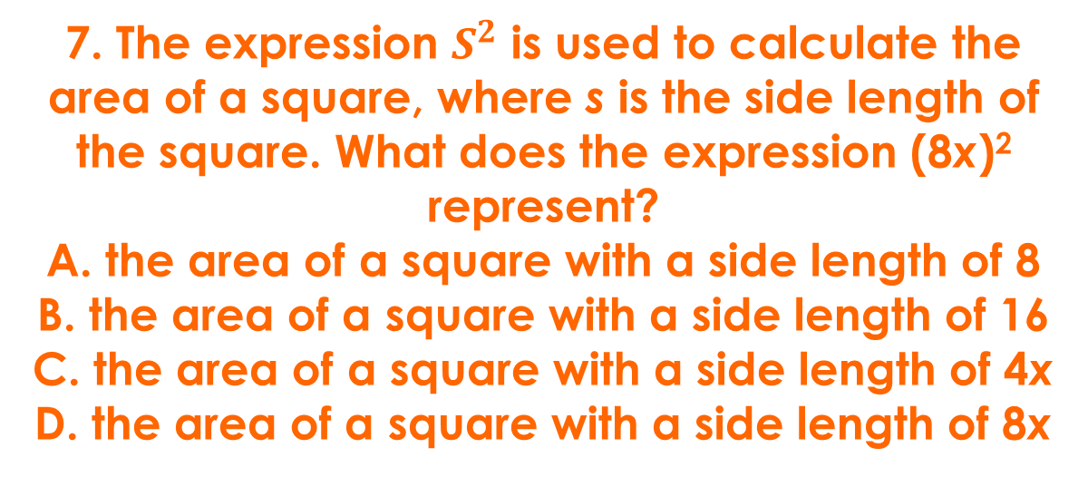
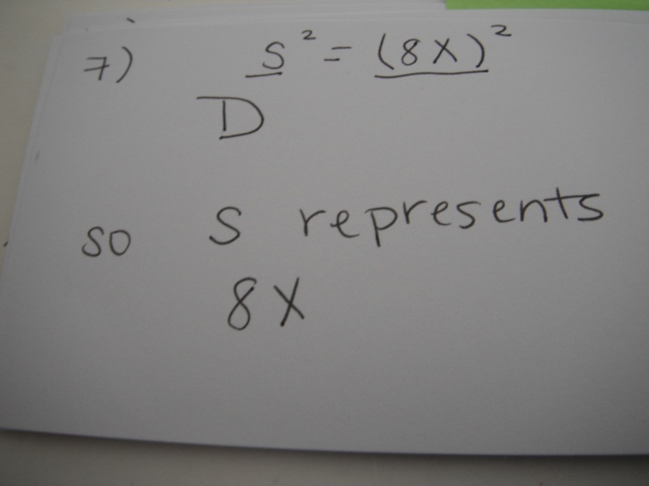

Slide 9
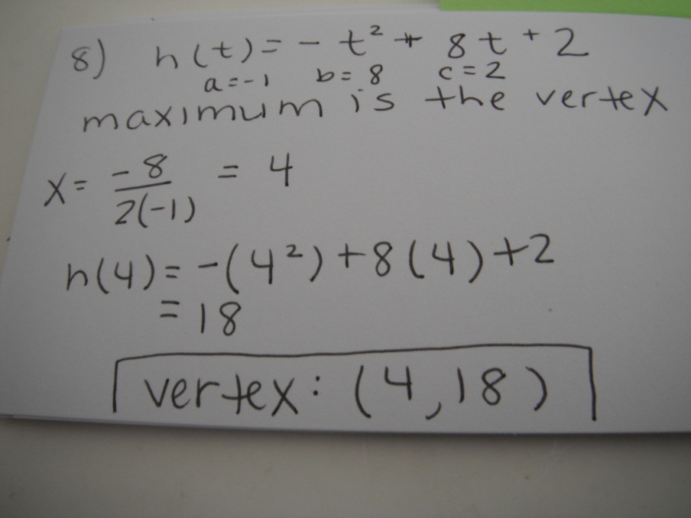
8. The function h(t) = –t² + 8t + 2 represents the height, in feet, of a stream of water being squirted out of a fountain after t seconds. What is the maximum height of the water?

Slide 10
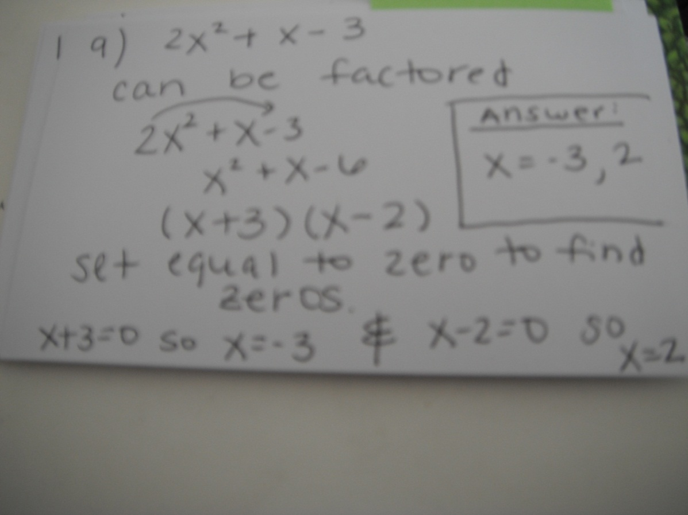
9. What are the zeros of the function represented by the quadratic expression 2x² + x – 3?

Slide 11
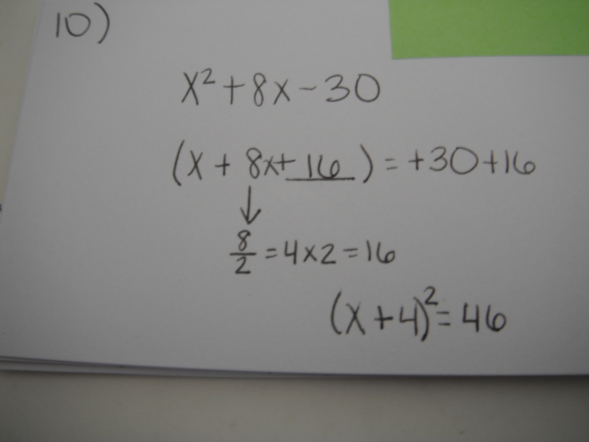
10. Factor the quadratic equation x² + 8x – 30 by completing the square.

Slide 12
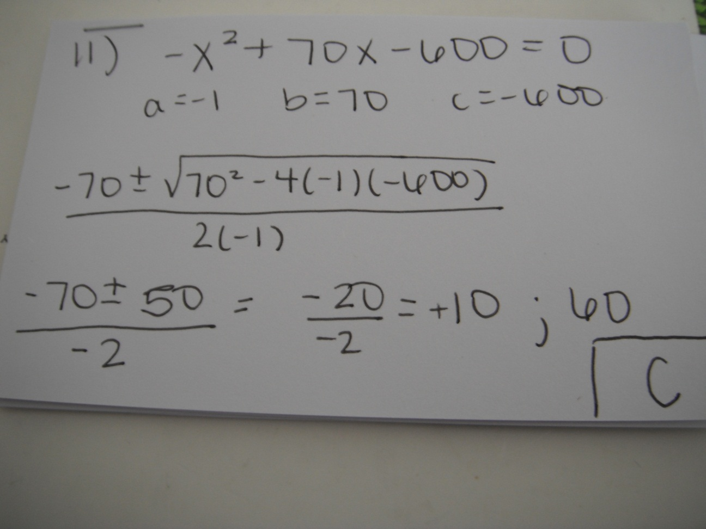
11. The expression –X² + 70x – 600 represents a company’s profit for selling x items. For which number(s) of items sold is the company’s profit equal to $0?
A. 0 items
B. 35 items
C. 10 items and 60 items
D. 20 items and 30 items

Slide 13
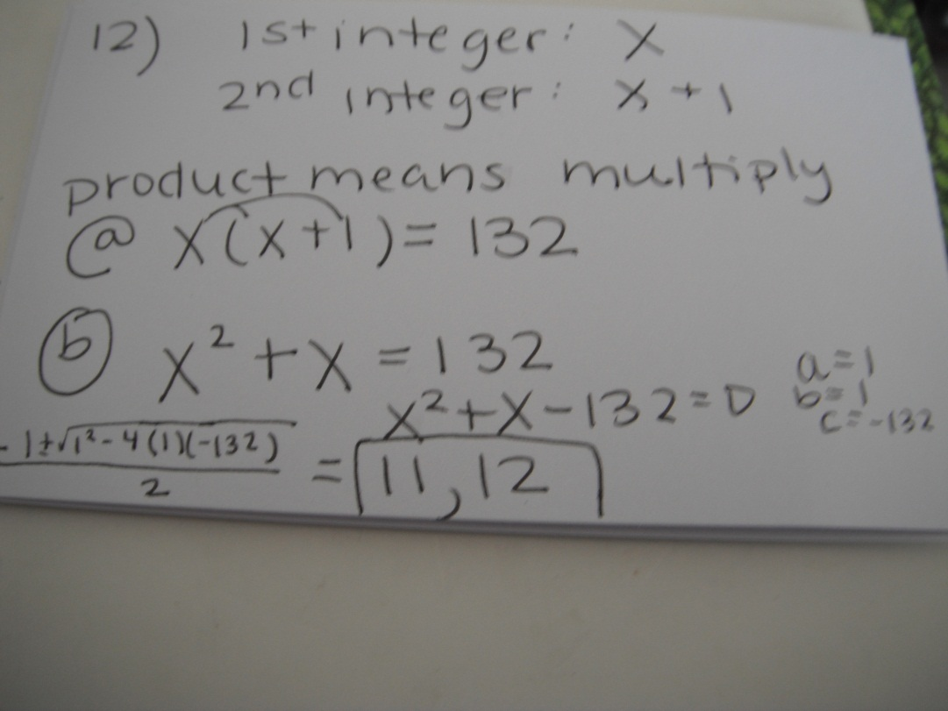
12. The product of two consecutive
positive integers is 132.
  Write an equation to model the situation.
  What are the two consecutive integers?

